Slide 1
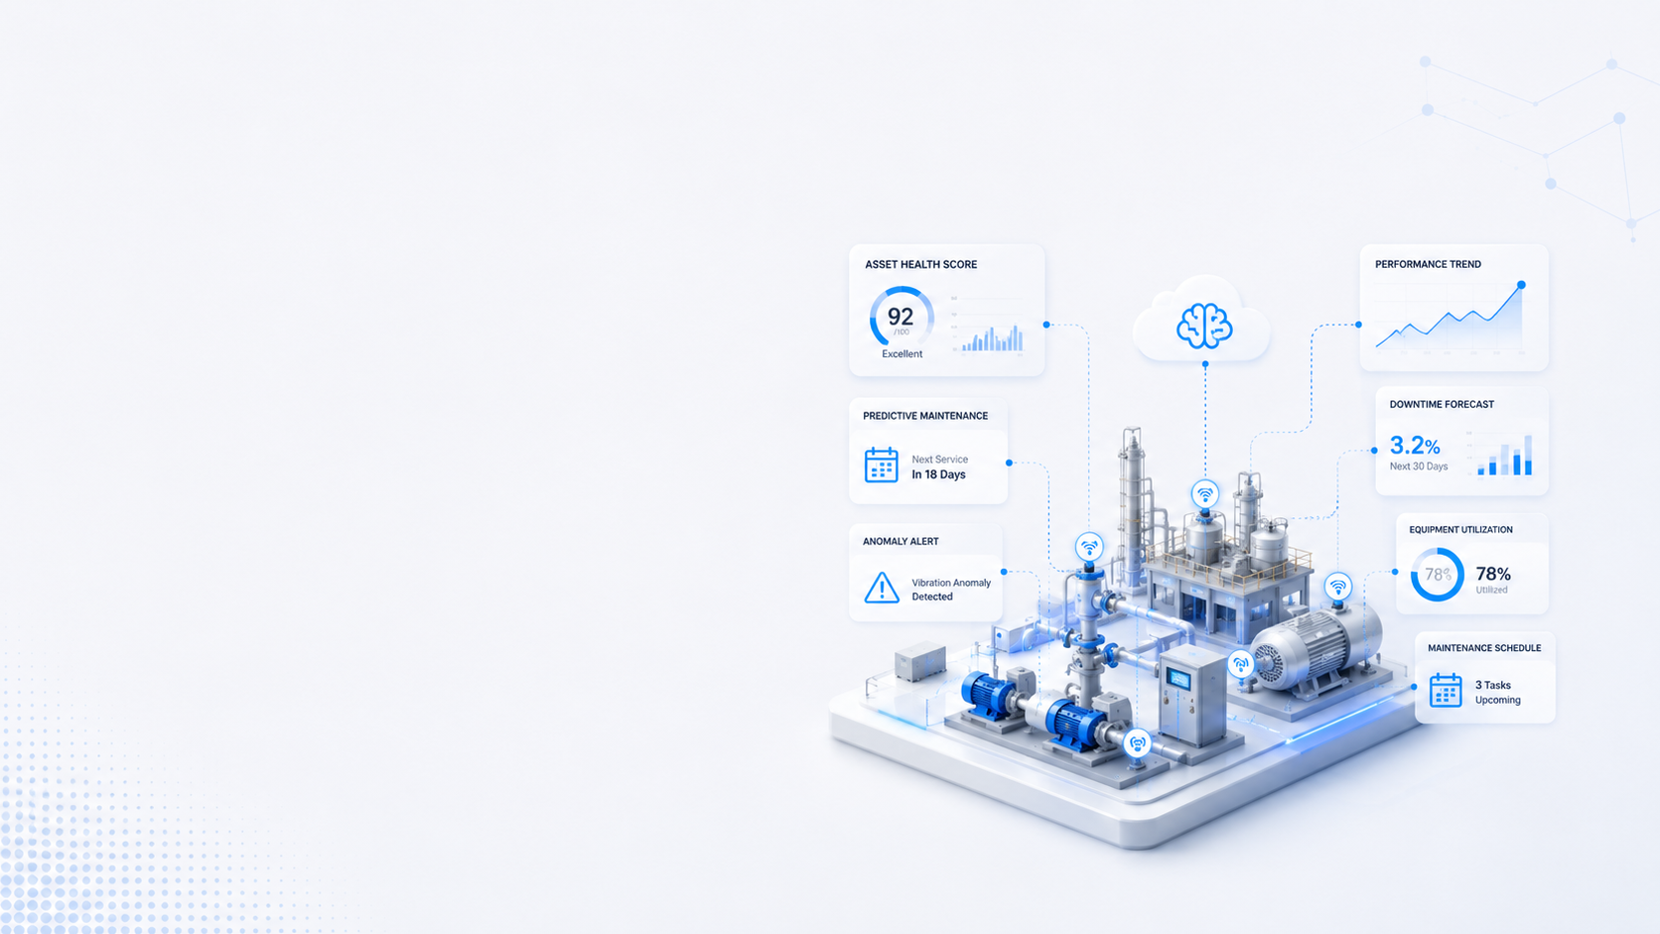


CASE STUDY
Geography: United States
Client Industry: Real Estate
Predictive
Analytics & Intelligent
Asset Monitoring
AI-enabled anomaly detection and predictive monitoring platform designed to optimize operational performance, infrastructure health, and asset intelligence for large-scale real estate operations.
02

Slide 2

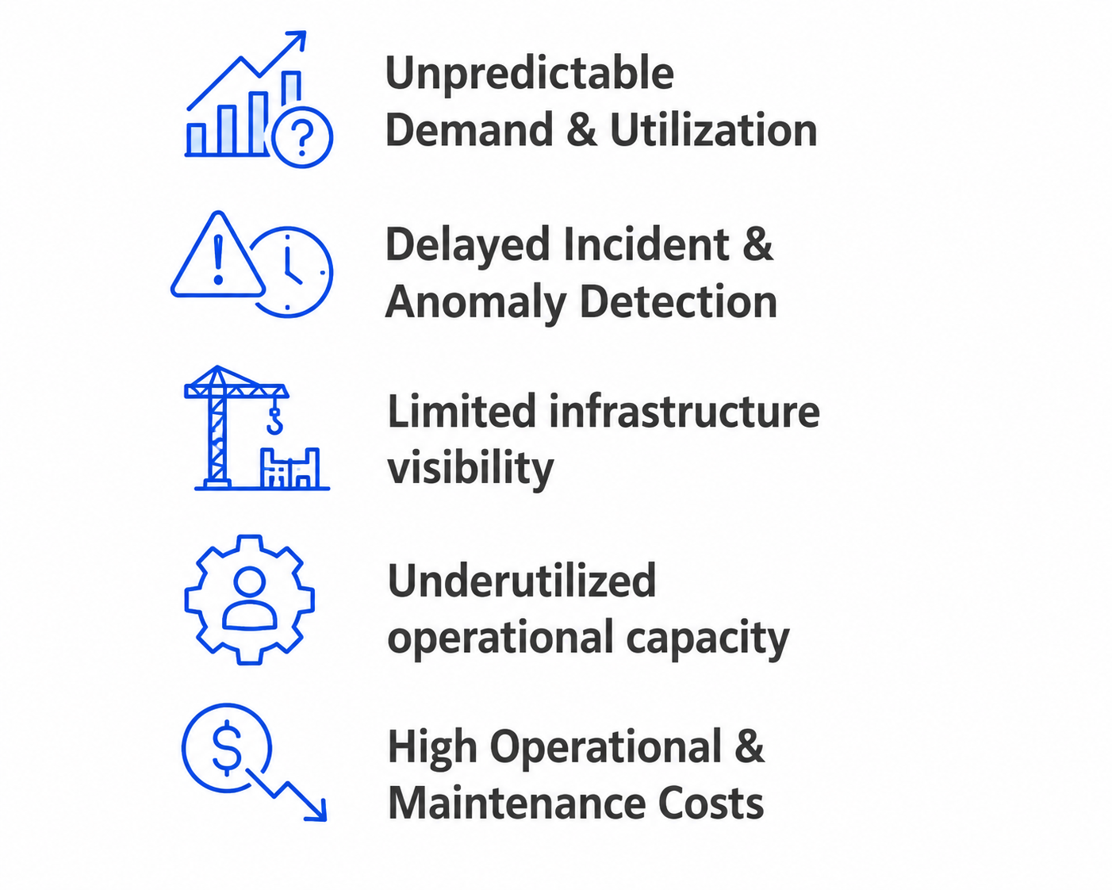
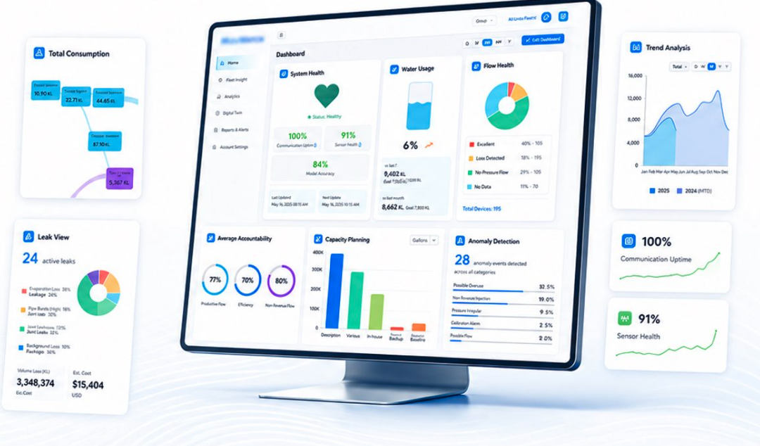







Smart Water Management & Parking Optimization
CASE STUDY
Predictive operational intelligence for utility monitoring and infrastructure optimization
Operational Challenges
Predictive Intelligence
Forecasts water consumption, parking occupancy, and resource demand using historical and real-time operational data.
Unpredictable Demand & Utilization
Demand Forecasting
Predicts parking availability, peak usage periods, and water demand trends to support proactive planning and resource allocation.
Limited infrastructure visibility
Utilization Optimization
Underutilized operational capacity
Monitors pumps, valves, sensors, parking assets, and network performance to improve utilization, reduce downtime, and extend asset life.
High Operational &
Maintenance Costs​
Intelligent Operational Insights
Provides AI-generated recommendations on water distribution efficiency, parking turnover, congestion management, and service performance.
Operational
Data
Predictive Analysis & Anomaly Detection
Insight
Operational
Decisions
03

Slide 3
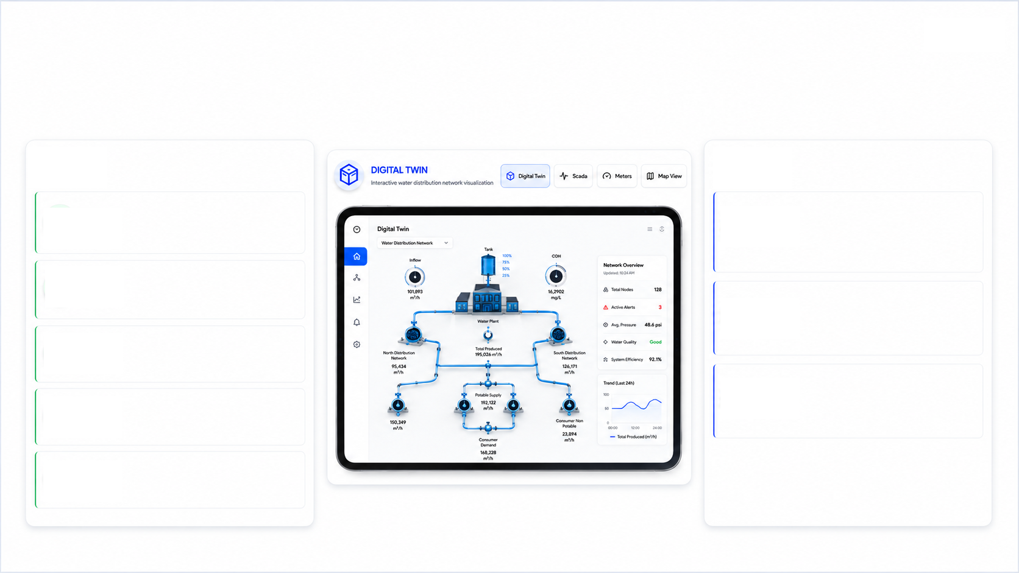









Operational Intelligence & Business Impact
CASE STUDY
AI-driven forecasting and optimization for smarter operational planning
Business Outcomes
Operational Intelligence
Improved Operational Visibility
Predictive Monitoring
Unified real-time view across the full infrastructure network
ML-powered analysis surfaces anomalies before field impact
Optimized Infra Usage
Capacity gaps identified and resolved before operational impact
Real-Time Intelligence
Live threshold monitoring alerts operators the moment patterns shift
Better Operational Planning
Forecast demand to plan resources weeks or months ahead
Operational Optimization
Predictive Decision-Making
Utilization analysis and demand forecasts drive smarter infrastructure decisions.
Executives act on AI-generated foresight, not reactive incident reports
AI-powered operational intelligence enabling proactive infrastructure management.
04

